Slide 1
Basic Statistical Concepts
Part 2.2 Descriptive Statistics, Random Variables,
Measures of Location / Dispersion

Slide 2
Descriptive Statistics
Q. What does the data look like using numbers?
Two ways to describe data:
Data visualization / statistical graphics (Part 1)
Summary measures
We may want to describe data with a few numbers.
Q. What is the ‘middle’ height in the class?
Measures of Location: Mean, Median, Mode
Q. How spread out are the heights in the class?
Measures of Dispersion / Spread: Variance, Standard Deviation, Range

Slide 3
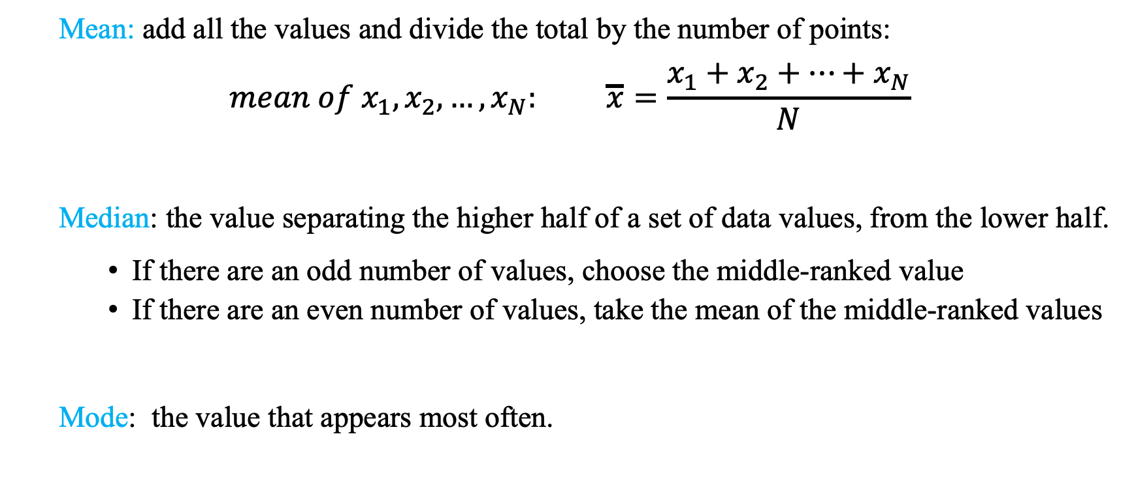
Measures of Location
Q. Where is most of the data?
Mean: add all the values and divide the total by the number of points:
$$mean of x_{1},x_{2},…,x_{N}: \overline{x}=\frac{x_{1}+x_{2}+…+x_{N}}{N}$$
Median: the value separating the higher half of a set of data values, from the lower half.
If there are an odd number of values, choose the middle-ranked value
If there are an even number of values, take the mean of the middle-ranked values
Mode: the value that appears most often.

Slide 4
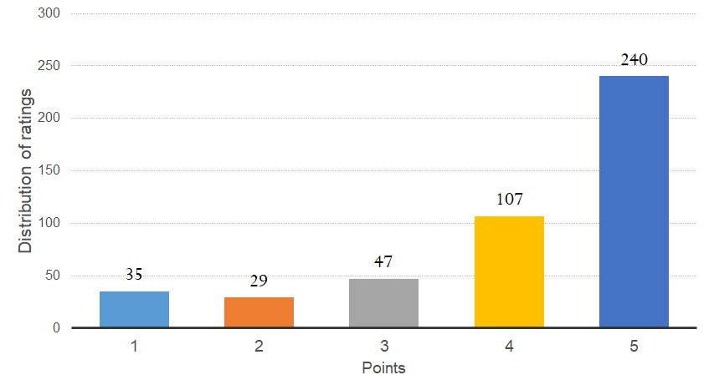
Measures of Location: Example
Q. Where is most of the data?
Data on customer ratings for Pittsburgh public transit in December 2017.
Mode: ?
Median: ?
Mean: ?

Slide 5
Measures of Location: Example
Q. Where is most of the data?
Data on customer ratings for Pittsburgh public transit in December 2017.
Mode: ?
Median: ?
Mean: ?
5

Slide 6
Measures of Location: Example
Q. Where is most of the data?
Data on customer ratings for Pittsburgh public transit in December 2017.
Mode: ?
Median: ?
Mean: ?
5
5

Slide 7
Measures of Location: Example
Q. Where is most of the data?
Data on customer ratings for Pittsburgh public transit in December 2017.
Mode: ?
Median: ?
Mean: ?
5
5

Slide 8
Measures of Location: Example
Q. Where is most of the data?
Data on customer ratings for Pittsburgh public transit in December 2017.
Mode: ?
Median: ?
Mean: ?
5
5
4.1

Slide 9
Measures of Location
Q. Where is most of the data?
Which one is better: Mean vs. Median vs. Mode
Make a guess:
Mean number of twitter followers = ?
Median number of twitter followers = ?
Depends on:
What we are trying to measure
Shape of the distributions of values
Median is a better measure of central value when a small number of outliers could drastically skew the mean

Slide 10
Measures of Dispersion
Q. How spread out is the data?
What do we mean by dispersion?
Deviation from the mean
How common is each deviation

Slide 11
Measures of Dispersion
Q. How spread out is the data?
What do we mean by dispersion?
Deviation from the mean
How common is each deviation
Types of measures of dispersion:
Range
Variance
Standard Deviation

Slide 12
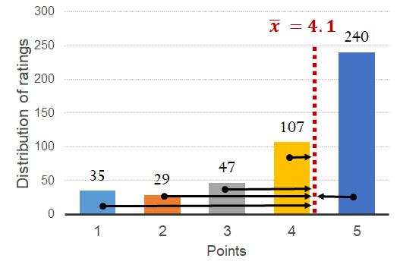
Measures of Dispersion
Q. How spread out is the data?
What do we mean by dispersion?
Deviation from the mean
How common is each deviation
Types of measures of dispersion:
Range
Variance
Standard Deviation

Slide 13
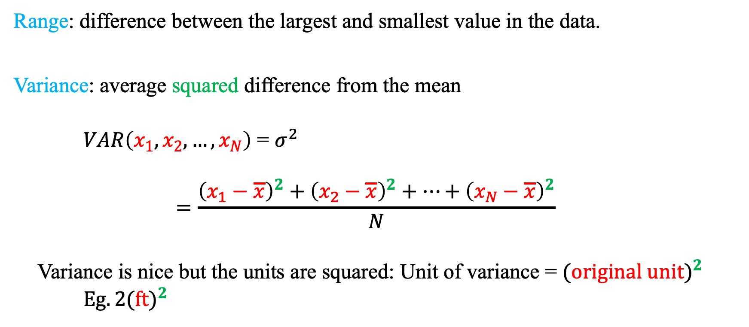
Measures of Dispersion
Q. How spread out is the data?
Range: difference between the largest and smallest value in the data.
Variance: average squared difference from the mean
$VAR\left(x_{1},x_{2},…,x_{N}\right)$ = $σ^{2}$
$$=\frac{{\left(x_{1}−\overline{x}\right)}^{2}+{\left(x_{2}−\overline{x}\right)}^{2}+…+{\left(x_{N}−\overline{x}\right)}^{2}}{N}$$
Variance is nice but the units are squared: Unit of variance = ${(original unit)}^{2}$
$Eg. {2(ft)}^{2}$

Slide 14
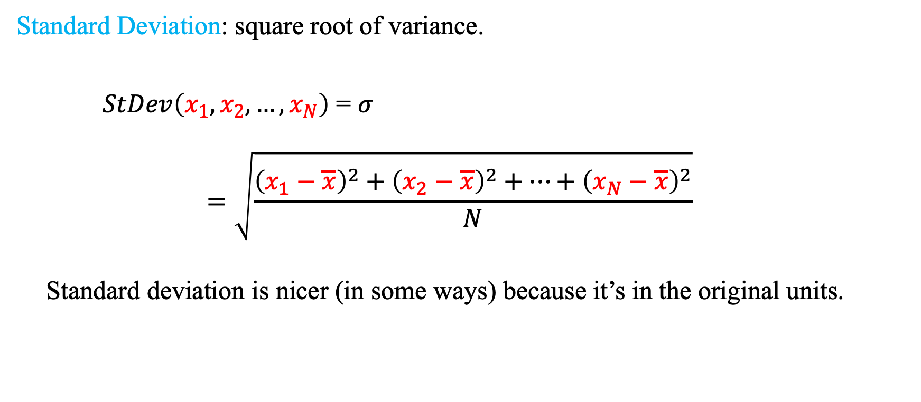
Measures of Dispersion
Q. How spread out is the data?
Standard Deviation: square root of variance.
$StDev\left(x_{1},x_{2},…,x_{N}\right)$ = $σ$
$$=\sqrt{\frac{{\left(x_{1}−\overline{x}\right)}^{2}+{\left(x_{2}−\overline{x}\right)}^{2}+…+{\left(x_{N}−\overline{x}\right)}^{2}}{N}}$$
Standard deviation is nicer (in some ways) because it’s in the original units.

Slide 15
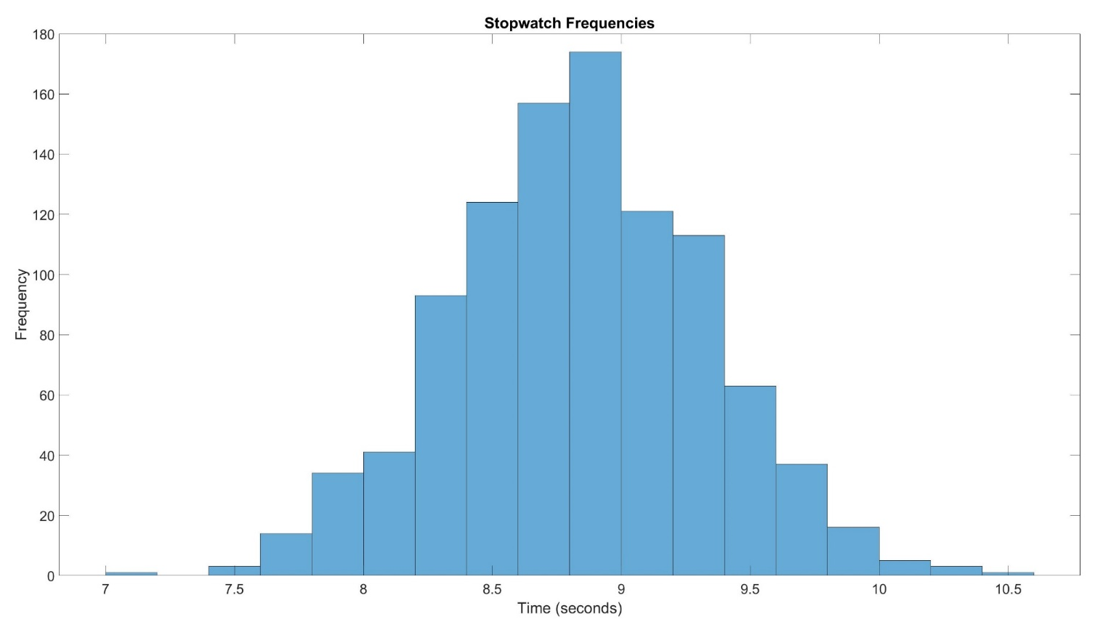
Summary Statistics: Example
Q. Summarize the ball drop times from the Empire State Building.
Mean = 8.9 sec

Slide 16



Summary Statistics: Example
Q. Summarize the ball drop times from the Empire State Building.
Mean = 8.9 sec
$σ$ = 0.6 sec
$$σ$$
$$σ$$

Slide 17
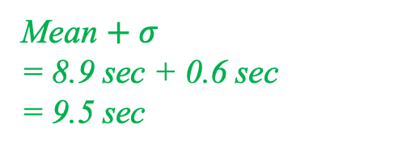

Summary Statistics: Example
Q. Summarize the ball drop times from the Empire State Building.
Mean = 8.9 sec
$σ$ = 0.6 sec
Mean $− σ$
= 8.9 sec – 0.6 sec
= 8.3 sec
Mean $+ σ$
= 8.9 sec + 0.6 sec
= 9.5 sec
$$σ$$
$$σ$$

Slide 18
Random Variables
Q. Is there a way to summarize random variables like we did with data?
We treat data as a realization of a random variable.
A random variable is a model of the data.
We can also describe the random variable.
Measures of Location
Measures of Dispersion / Spread
Summary statistics describe the data, which are realizations, not the underlying random variable itself.
Now we use information about the likelihood of each outcome of X
This information is contained in the probability distribution of X

Slide 19
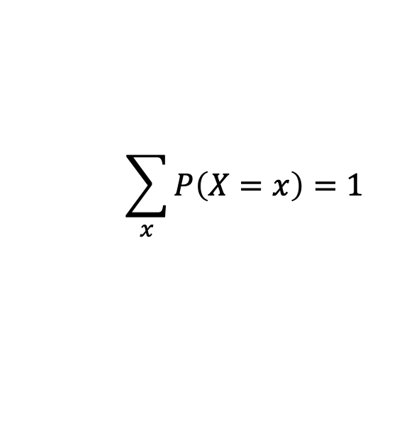
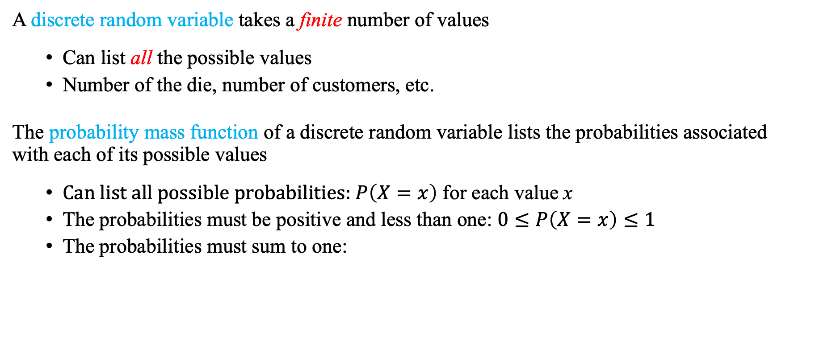
Discrete Random Variables
A discrete random variable takes a finite number of values
Can list all the possible values
Number of the die, number of customers, etc.
The probability mass function of a discrete random variable lists the probabilities associated with each of its possible values
Can list all possible probabilities: $P\left(X=x\right)$ for each value x
The probabilities must be positive and less than one: $0≤P\left(X=x\right)≤1$
The probabilities must sum to one:
$$\sum_{x}{P\left(X=x\right)=1}$$

Slide 20
Discrete Random Variables: Example
Q. Let X take 5 different values.
Values of X | Probability of Occurrence
X = 1 | P(X = 1) = 0.12
X = 2 | P(X = 2) = 0.4
X = 3 | P(X = 3) = 0.35
X = 4 | P(X = 4) = 0.03
X = 5 | P(X = 5) = 0.1
$$\sum_{x}{P\left(X=x\right)=1}$$

Slide 21
Discrete Random Variables: Example
Q. Let X take 5 different values.
Values of X | Probability of Occurrence
X = 1 | P(X = 1) = 0.12
X = 2 | P(X = 2) = 0.4
X = 3 | P(X = 3) = 0.35
X = 4 | P(X = 4) = 0.03
X = 5 | P(X = 5) = 0.1
Sum = 1
$$\sum_{x}{P\left(X=x\right)=1}$$

Slide 22
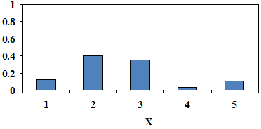
Discrete Random Variables: Example
Probability Distribution:
Probability that value of X is equal to x
0.4
0.35
$$P\left(X=x\right)$$
0.12
0.1
0.03

Slide 23
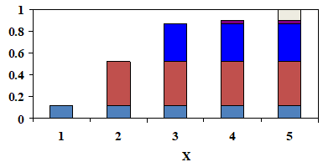
Discrete Random Variables: Example
Probability Distribution:
Probability that value of X is equal to x
0.4
0.35
$$P\left(X=x\right)$$
0.12
0.1
0.03
Cumulative Probability Distribution
Probability that value of X is smaller than or equal to x
$$P\left(X≤x\right)$$

Slide 24
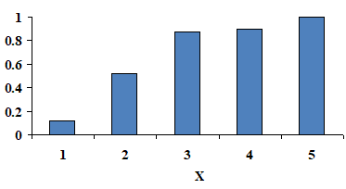
Discrete Random Variables: Example
Probability Distribution:
Probability that value of X is equal to x
0.4
0.35
$$P\left(X=x\right)$$
0.12
0.1
0.03
Cumulative Probability Distribution
Probability that value of X is smaller than or equal to x
$$P\left(X≤x\right)$$
$$P\left(X≤1\right)=P\left(X=1\right)$$

Slide 25
Discrete Random Variables: Example
Probability Distribution:
Probability that value of X is equal to x
0.4
0.35
$$P\left(X=x\right)$$
0.12
0.1
0.03
Cumulative Probability Distribution
Probability that value of X is smaller than or equal to x
$$P\left(X≤x\right)$$
$$P\left(X≤1\right)=P\left(X=1\right)$$
$$P\left(X≤2\right)=P\left(X=1\right)+P\left(X=2\right)$$

Slide 26

Discrete Random Variables: Example
Probability Distribution:
Probability that value of X is equal to x
0.4
0.35
$$P\left(X=x\right)$$
0.12
0.1
0.03
Cumulative Probability Distribution
Probability that value of X is smaller than or equal to x
$$P\left(X≤x\right)$$
$$P\left(X≤1\right)=P\left(X=1\right)$$
$$P\left(X≤2\right)=P\left(X=1\right)+P\left(X=2\right)$$
$$P\left(X≤3\right)=P\left(X=1\right)+P\left(X=2\right)$$
$$+ P\left(X=3\right)$$

Slide 27


Discrete Random Variables: Expected Value
A random variable X can take a number of different values:
with corresponding probabilities:
Expected Value of a random variable X:$\left(denoted as μ_{X} \text{or} E\left(X\right)\right)$
$x_{1}$, $x_{2},$...
${P(X=x}_{1})$, ${ P(X=x}_{2})$, ...
$$μ_{X}={{ x}_{1}∙P(X=x}_{1})\text{ +}{{ x}_{2}∙P(X=x}_{2})+…$$

Slide 28
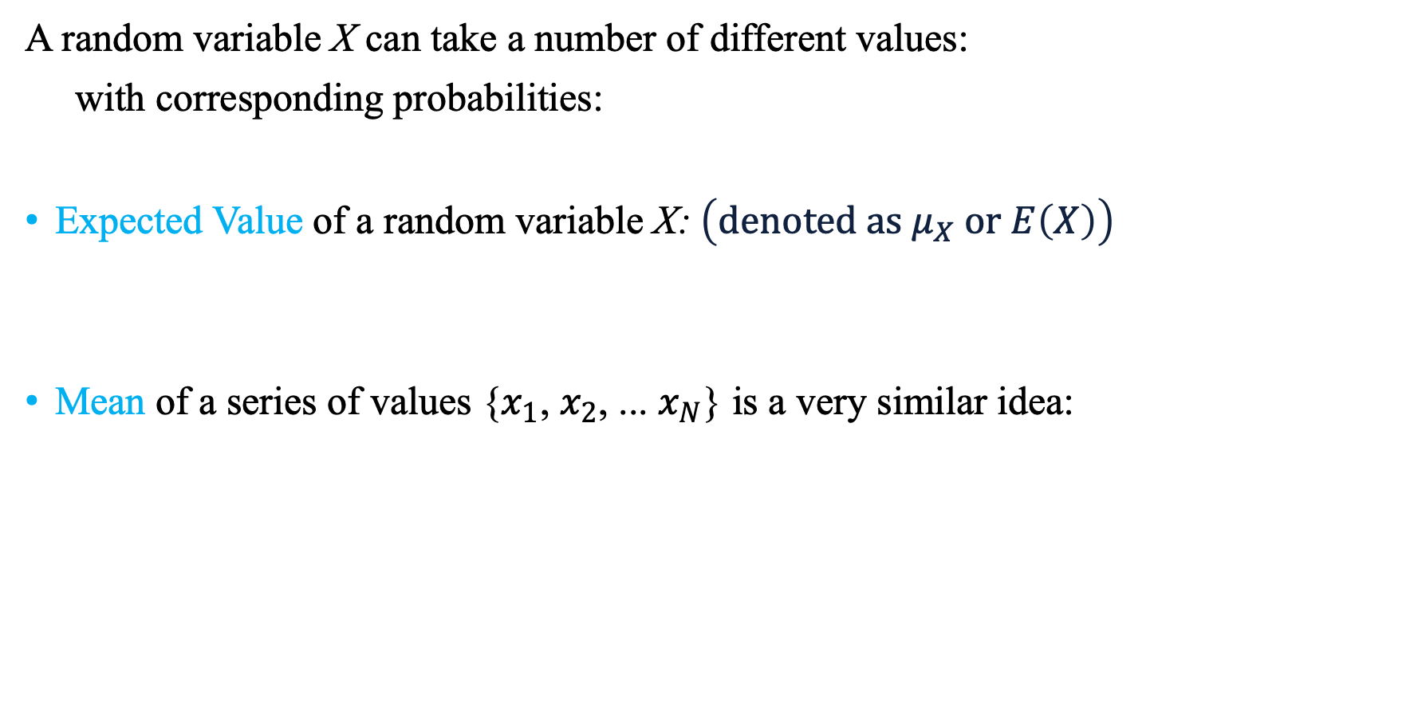
Discrete Random Variables: Expected Value
A random variable X can take a number of different values:
with corresponding probabilities:
Expected Value of a random variable X:$\left(denoted as μ_{X} \text{or} E\left(X\right)\right)$
Mean of a series of values {$x_{1}$, $x_{2}$, ... $x_{N}$} is a very similar idea:
$x_{1}$, $x_{2},$...
${P(X=x}_{1})$, ${ P(X=x}_{2})$, ...
$$μ_{X}={{ x}_{1}∙P(X=x}_{1})\text{ +}{{ x}_{2}∙P(X=x}_{2})+…$$
$$\overline{x}=\frac{x_{1}+x_{2}+…+x_{N}}{N} = x_{1}∙\frac{1}{N} +{ x}_{2}∙\frac{1}{N} + …+x_{N}∙\frac{1}{N}$$

Slide 29
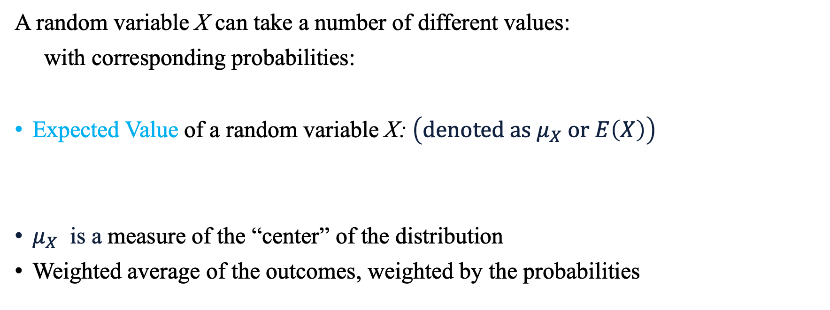
Discrete Random Variables: Expected Value
A random variable X can take a number of different values:
with corresponding probabilities:
Expected Value of a random variable X:$\left(denoted as μ_{X} \text{or} E\left(X\right)\right)$
$μ_{X}$ is a measure of the “center” of the distribution
Weighted average of the outcomes, weighted by the probabilities
$x_{1}$, $x_{2},$...
${P(X=x}_{1})$, ${ P(X=x}_{2})$, ...
$$μ_{X}={{ x}_{1}∙P(X=x}_{1})\text{ +}{{ x}_{2}∙P(X=x}_{2})+…$$

Slide 30
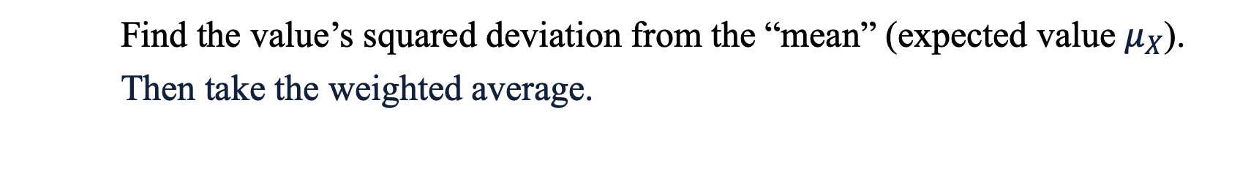
Discrete Random Variables: Variance
Variance of random variable X: (denoted as $σ_{X}^{2}$ or Var(X))
$$σ_{X}^{2}={{{ (x}_{1} − μ_{X})}^{2}∙P(X=x}_{1})\text{ +}{{{ (x}_{2} − μ_{X})}^{2}∙P(X=x}_{2})+…$$
Find the value’s squared deviation from the “mean” (expected value $μ_{X}$).
Then take the weighted average.

Slide 31
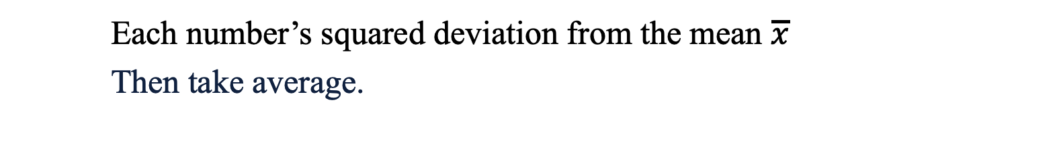
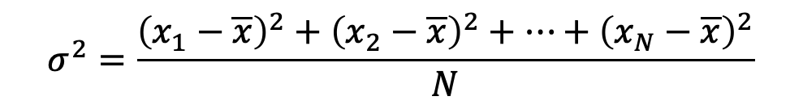
Discrete Random Variables: Variance
Variance of random variable X: (denoted as $σ_{X}^{2}$ or Var(X))
$$σ_{X}^{2}={{{ (x}_{1} − μ_{X})}^{2}∙P(X=x}_{1})\text{ +}{{{ (x}_{2} − μ_{X})}^{2}∙P(X=x}_{2})+…$$
Find the value’s squared deviation from the “mean” (expected value $μ_{X}$).
Then take the weighted average.
Variance of a series of numbers {$x_{1}$, $x_{2}$, ... $x_{N}$}
$$σ^{2}=\frac{{\left(x_{1}−\overline{x}\right)}^{2}+{\left(x_{2}−\overline{x}\right)}^{2}+…+{\left(x_{N}−\overline{x}\right)}^{2}}{N}$$
Each number’s squared deviation from the mean $\overline{x}$
Then take average.

Slide 32

Discrete Random Variables: Standard Deviation
Standard Deviation of random variable X: (denoted as $σ_{X}$)
$$σ_{X}=\sqrt{σ_{X}^{2}}=\sqrt{Var(X)}$$
… a measure of the dispersion of the distribution in original units.

Slide 33
Discrete Random Variables: Summary
Discrete Random Variable: numerical valued outcomes, can list all possible values it may take
Mean (expected value) of X:
$$E\left(X\right)=μ_{X}=x_{1}∙P\left(X=x_{1}\right)+x_{2}∙P\left(X=x_{2}\right)+…$$

Slide 34
Discrete Random Variables: Summary
Discrete Random Variable: numerical valued outcomes, can list all possible values it may take
Mean (expected value) of X:
Variance of X:
$$E\left(X\right)=μ_{X}=x_{1}∙P\left(X=x_{1}\right)+x_{2}∙P\left(X=x_{2}\right)+…$$
$$Var\left(X\right)=σ_{X}^{2}={{(x}_{1}−μ_{X})}^{2}∙P\left(X=x_{1}\right)+{{(x}_{2}−μ_{X})}^{2}∙P\left(X=x_{2}\right)+…$$

Slide 35
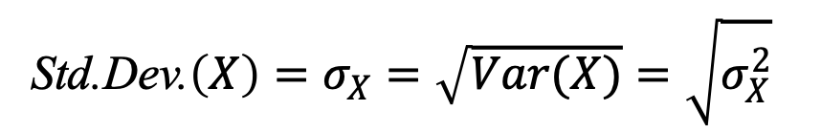
Discrete Random Variables: Summary
Discrete Random Variable: numerical valued outcomes, can list all possible values it may take
Mean (expected value) of X:
Variance of X:
Standard deviation of X:
$$E\left(X\right)=μ_{X}=x_{1}∙P\left(X=x_{1}\right)+x_{2}∙P\left(X=x_{2}\right)+…$$
$$Var\left(X\right)=σ_{X}^{2}={{(x}_{1}−μ_{X})}^{2}∙P\left(X=x_{1}\right)+{{(x}_{2}−μ_{X})}^{2}∙P\left(X=x_{2}\right)+…$$
Std.Dev.$\left(X\right)=σ_{X}=\sqrt{Var(X)}=\sqrt{σ_{X}^{2}}$

Slide 36


Example: A Bet With A Rich Person
“We’ll toss a coin once:
If it is heads, you get $10 million.
If it is tails, you’ll have to pay me $1 million”
What are expected value, variance, and standard deviation of the change in your wealth after this coin toss?
$X$ = change in your wealth (in millions of dollars)
Notes:
Boardwriting: of a probability tree:
X leads to two branches:
On the upper side of the branches: (Event A: X=10) and (Event B: X=-1)
On the lower side of the branches: P(event A) = P(X=10) = ½, P(event B)=P(X=-1) = ½
Add small downward arrows to say that 10 is x1, and -1 is x2
But you are not guaranteed $4.5 million! To see why:
50% chance to get $10 million ⇒ $5.5 million more than expected
50% chance to lose $1 million ⇒ $5.5 million less than expected

Slide 37
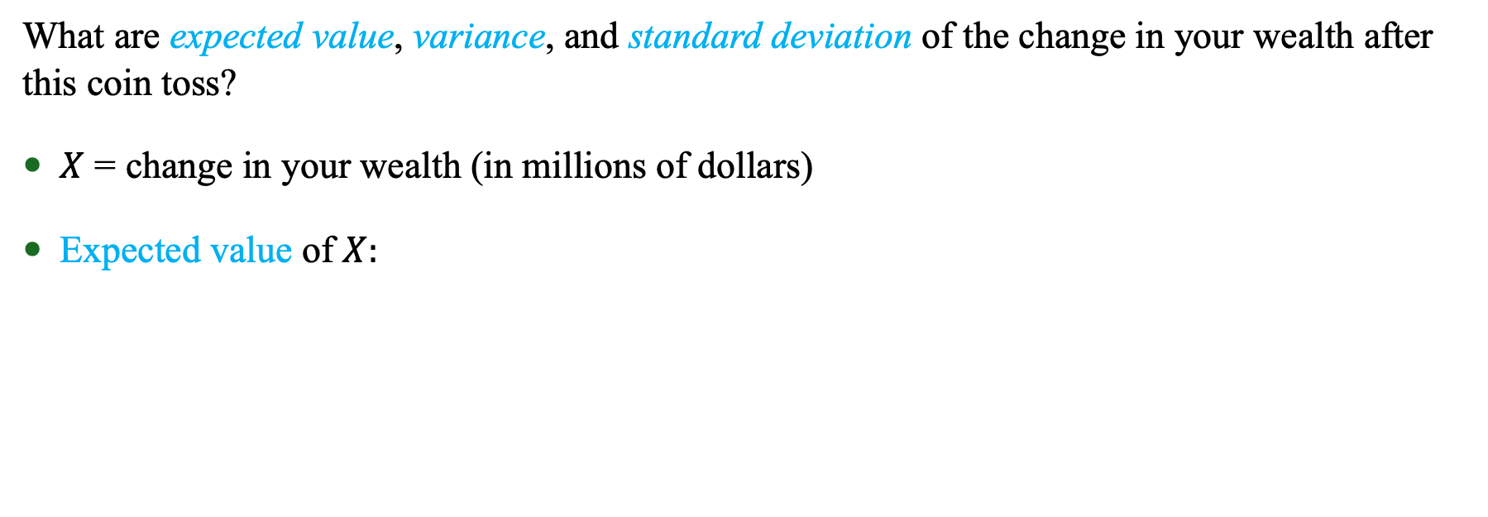
Example: A Bet With A Rich Person
“We’ll toss a coin once:
If it is heads, you get $10 million.
If it is tails, you’ll have to pay me $1 million”
What are expected value, variance, and standard deviation of the change in your wealth after this coin toss?
$X$ = change in your wealth (in millions of dollars)
Expected value of $X:$
$$μ_{X}= x_{1}∙P\left(X=x_{1}\right)+x_{2}∙P(X=x_{2})$$
Notes:
Boardwriting: of a probability tree:
X leads to two branches:
On the upper side of the branches: (Event A: X=10) and (Event B: X=-1)
On the lower side of the branches: P(event A) = P(X=10) = ½, P(event B)=P(X=-1) = ½
Add small downward arrows to say that 10 is x1, and -1 is x2
But you are not guaranteed $4.5 million! To see why:
50% chance to get $10 million ⇒ $5.5 million more than expected
50% chance to lose $1 million ⇒ $5.5 million less than expected

Slide 38
Example: A Bet With A Rich Person
“We’ll toss a coin once:
If it is heads, you get $10 million.
If it is tails, you’ll have to pay me $1 million”
What are expected value, variance, and standard deviation of the change in your wealth after this coin toss?
$X$ = change in your wealth (in millions of dollars)
Expected value of $X:$
$$μ_{X}= x_{1}∙P\left(X=x_{1}\right)+x_{2}∙P(X=x_{2})$$
$$= \left(10\right)∙P(X=10)+ \left(−1\right)∙P(X=−1)$$
Notes:
Boardwriting: of a probability tree:
X leads to two branches:
On the upper side of the branches: (Event A: X=10) and (Event B: X=-1)
On the lower side of the branches: P(event A) = P(X=10) = ½, P(event B)=P(X=-1) = ½
Add small downward arrows to say that 10 is x1, and -1 is x2
But you are not guaranteed $4.5 million! To see why:
50% chance to get $10 million ⇒ $5.5 million more than expected
50% chance to lose $1 million ⇒ $5.5 million less than expected

Slide 39


Example: A Bet With A Rich Person
“We’ll toss a coin once:
If it is heads, you get $10 million.
If it is tails, you’ll have to pay me $1 million”
What are expected value, variance, and standard deviation of the change in your wealth after this coin toss?
$X$ = change in your wealth (in millions of dollars)
Expected value of $X:$
$$μ_{X}= x_{1}∙P\left(X=x_{1}\right)+x_{2}∙P(X=x_{2})$$
$$= \left(10\right)∙P(X=10)+ \left(−1\right)∙P(X=−1)$$
$= \left(10\right)∙\frac{1}{2} +\left(−1\right)∙\frac{1}{2}$
$=4.5 (\$ million$)
Notes:
Boardwriting: of a probability tree:
X leads to two branches:
On the upper side of the branches: (Event A: X=10) and (Event B: X=-1)
On the lower side of the branches: P(event A) = P(X=10) = ½, P(event B)=P(X=-1) = ½
Add small downward arrows to say that 10 is x1, and -1 is x2
But you are not guaranteed $4.5 million! To see why:
50% chance to get $10 million ⇒ $5.5 million more than expected
50% chance to lose $1 million ⇒ $5.5 million less than expected

Slide 40

Example: A Bet With A Rich Person
“We’ll toss a coin once:
If it is heads, you get $10 million.
If it is tails, you’ll have to pay me $1 million”
Variance of $X:$
$$σ_{X}^{2}={\left(x_{1}−μ_{X}\right)}^{2}∙P(X=x_{1})+{\left(x_{2}−μ_{X}\right)}^{2}∙P(X=x_{2})$$
Notes:
Boardwriting: of a probability tree:
X leads to two branches:
On the upper side of the branches: (Event A: X=10) and (Event B: X=-1)
On the lower side of the branches: P(event A) = P(X=10) = ½, P(event B)=P(X=-1) = ½
Add small downward arrows to say that 10 is x1, and -1 is x2
But you are not guaranteed $4.5 million! To see why:
50% chance to get $10 million ⇒ $5.5 million more than expected
50% chance to lose $1 million ⇒ $5.5 million less than expected

Slide 41
Example: A Bet With A Rich Person
“We’ll toss a coin once:
If it is heads, you get $10 million.
If it is tails, you’ll have to pay me $1 million”
Variance of $X:$
$$σ_{X}^{2}={\left(x_{1}−μ_{X}\right)}^{2}∙P(X=x_{1})+{\left(x_{2}−μ_{X}\right)}^{2}∙P(X=x_{2})$$
$={\left(10−μ_{X}\right)}^{2}∙P(X=10)+{\left(−1−μ_{X}\right)}^{2}∙P(X=−1)$
Notes:
Boardwriting: of a probability tree:
X leads to two branches:
On the upper side of the branches: (Event A: X=10) and (Event B: X=-1)
On the lower side of the branches: P(event A) = P(X=10) = ½, P(event B)=P(X=-1) = ½
Add small downward arrows to say that 10 is x1, and -1 is x2
But you are not guaranteed $4.5 million! To see why:
50% chance to get $10 million ⇒ $5.5 million more than expected
50% chance to lose $1 million ⇒ $5.5 million less than expected

Slide 42
Example: A Bet With A Rich Person
“We’ll toss a coin once:
If it is heads, you get $10 million.
If it is tails, you’ll have to pay me $1 million”
Variance of $X:$
$$σ_{X}^{2}={\left(x_{1}−μ_{X}\right)}^{2}∙P(X=x_{1})+{\left(x_{2}−μ_{X}\right)}^{2}∙P(X=x_{2})$$
$={\left(10−μ_{X}\right)}^{2}∙P(X=10)+{\left(−1−μ_{X}\right)}^{2}∙P(X=−1)$
$$={\left(10−4.5\right)}^{2}∙P(X=10)+{\left(−1−4.5\right)}^{2}∙P(X=−1)$$
Notes:
Boardwriting: of a probability tree:
X leads to two branches:
On the upper side of the branches: (Event A: X=10) and (Event B: X=-1)
On the lower side of the branches: P(event A) = P(X=10) = ½, P(event B)=P(X=-1) = ½
Add small downward arrows to say that 10 is x1, and -1 is x2
But you are not guaranteed $4.5 million! To see why:
50% chance to get $10 million ⇒ $5.5 million more than expected
50% chance to lose $1 million ⇒ $5.5 million less than expected

Slide 43
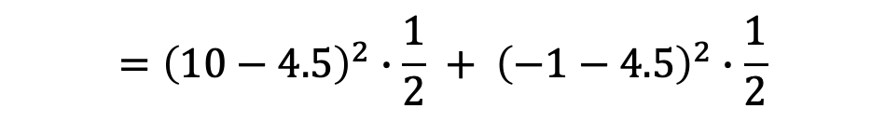
Example: A Bet With A Rich Person
“We’ll toss a coin once:
If it is heads, you get $10 million.
If it is tails, you’ll have to pay me $1 million”
Variance of $X:$
$$σ_{X}^{2}={\left(x_{1}−μ_{X}\right)}^{2}∙P(X=x_{1})+{\left(x_{2}−μ_{X}\right)}^{2}∙P(X=x_{2})$$
$={\left(10−μ_{X}\right)}^{2}∙P(X=10)+{\left(−1−μ_{X}\right)}^{2}∙P(X=−1)$
$$={\left(10−4.5\right)}^{2}∙P(X=10)+{\left(−1−4.5\right)}^{2}∙P(X=−1)$$
$$={\left(10−4.5\right)}^{2}∙\frac{1}{2} + {\left(−1−4.5\right)}^{2}∙\frac{1}{2}$$
Notes:
Boardwriting: of a probability tree:
X leads to two branches:
On the upper side of the branches: (Event A: X=10) and (Event B: X=-1)
On the lower side of the branches: P(event A) = P(X=10) = ½, P(event B)=P(X=-1) = ½
Add small downward arrows to say that 10 is x1, and -1 is x2
But you are not guaranteed $4.5 million! To see why:
50% chance to get $10 million ⇒ $5.5 million more than expected
50% chance to lose $1 million ⇒ $5.5 million less than expected

Slide 44


Example: A Bet With A Rich Person
“We’ll toss a coin once:
If it is heads, you get $10 million.
If it is tails, you’ll have to pay me $1 million”
Variance of $X:$
$$σ_{X}^{2}={\left(x_{1}−μ_{X}\right)}^{2}∙P(X=x_{1})+{\left(x_{2}−μ_{X}\right)}^{2}∙P(X=x_{2})$$
$={\left(10−μ_{X}\right)}^{2}∙P(X=10)+{\left(−1−μ_{X}\right)}^{2}∙P(X=−1)$
$$={\left(10−4.5\right)}^{2}∙P(X=10)+{\left(−1−4.5\right)}^{2}∙P(X=−1)$$
$$={\left(10−4.5\right)}^{2}∙\frac{1}{2} + {\left(−1−4.5\right)}^{2}∙\frac{1}{2}$$
$$={(5.5)}^{2}∙0.5+ {\left(−5.5\right)}^{2}∙0.5$$
$$={30.25 (\$ million}^{2})$$
Notes:
Boardwriting: of a probability tree:
X leads to two branches:
On the upper side of the branches: (Event A: X=10) and (Event B: X=-1)
On the lower side of the branches: P(event A) = P(X=10) = ½, P(event B)=P(X=-1) = ½
Add small downward arrows to say that 10 is x1, and -1 is x2
But you are not guaranteed $4.5 million! To see why:
50% chance to get $10 million ⇒ $5.5 million more than expected
50% chance to lose $1 million ⇒ $5.5 million less than expected

Slide 45



Example: A Bet With A Rich Person
“We’ll toss a coin once:
If it is heads, you get $10 million.
If it is tails, you’ll have to pay me $1 million”
Standard Deviation of $X:$
$$σ_{X}=\sqrt{σ_{X}^{2}}$$
$$=\sqrt{30.25}$$
$$=5.5 (\$ million)$$
Notes:
Boardwriting: of a probability tree:
X leads to two branches:
On the upper side of the branches: (Event A: X=10) and (Event B: X=-1)
On the lower side of the branches: P(event A) = P(X=10) = ½, P(event B)=P(X=-1) = ½
Add small downward arrows to say that 10 is x1, and -1 is x2
But you are not guaranteed $4.5 million! To see why:
50% chance to get $10 million ⇒ $5.5 million more than expected
50% chance to lose $1 million ⇒ $5.5 million less than expected

Slide 46
Example: Sales Calls
A salesperson for a national clothing company makes five calls to potential customers every day.
The following probability distribution describes the number of successful calls each day:
How many successful calls does this salesperson expect to make each day?

Slide 47
Continuous Random Variables
Q. What if the data is continuous?
A continuous random variable takes an infinite number of values
Cannot list all the possible values
Weight, height, time, etc.

Slide 48
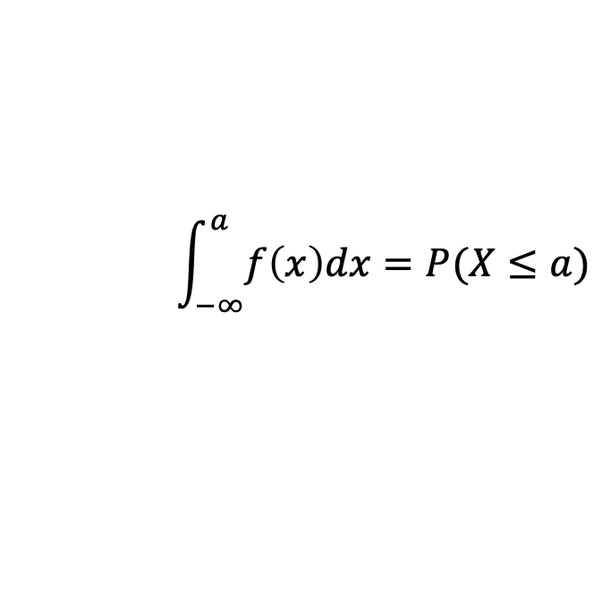
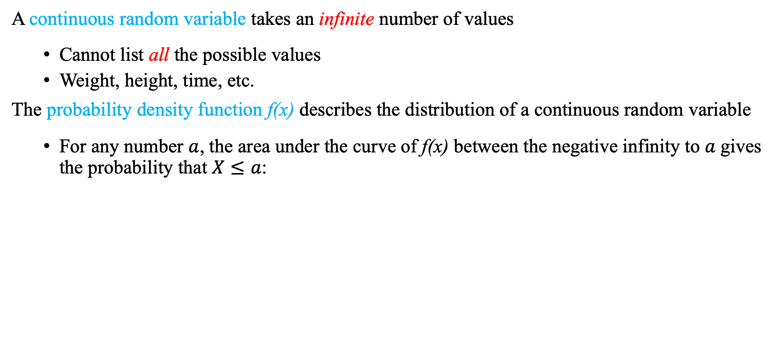
Continuous Random Variables
Q. What if the data is continuous?
A continuous random variable takes an infinite number of values
Cannot list all the possible values
Weight, height, time, etc.
The probability density function f(x) describes the distribution of a continuous random variable
For any number $a$, the area under the curve of f(x) between the negative infinity to $a$gives the probability that $X≤a$:
$$\int_{−∞}^{a}{f\left(x\right)dx=P(X≤a)}$$

Slide 49
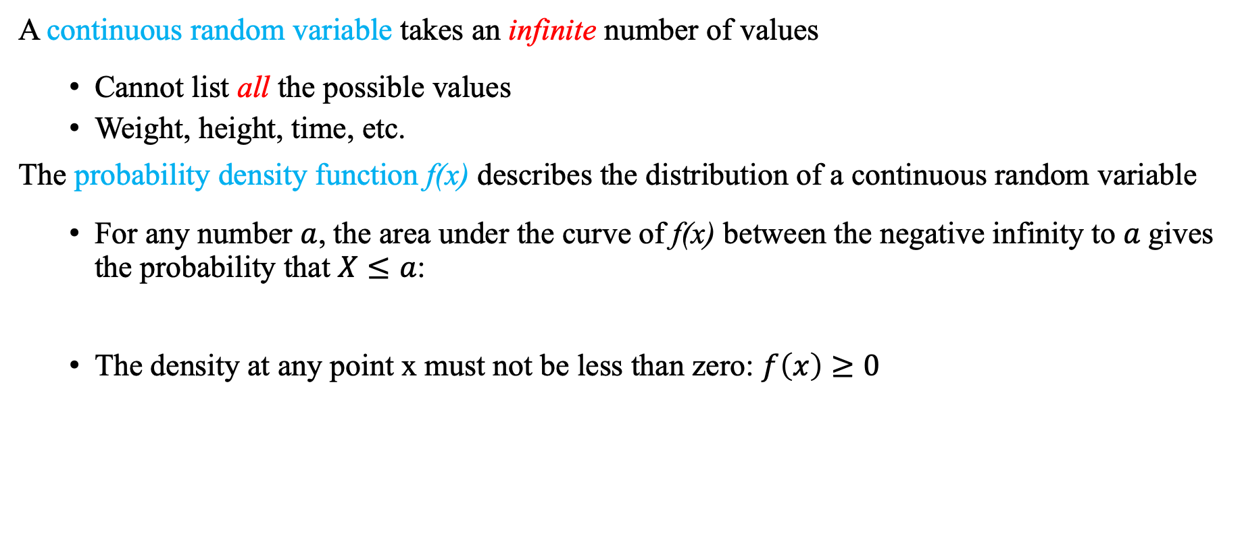
Continuous Random Variables
Q. What if the data is continuous?
A continuous random variable takes an infinite number of values
Cannot list all the possible values
Weight, height, time, etc.
The probability density function f(x) describes the distribution of a continuous random variable
For any number $a$, the area under the curve of f(x) between the negative infinity to $a$gives the probability that $X≤a$:
The density at any point x must not be less than zero: $f\left(x\right)≥0$
$$\int_{−∞}^{a}{f\left(x\right)dx=P(X≤a)}$$

Slide 50
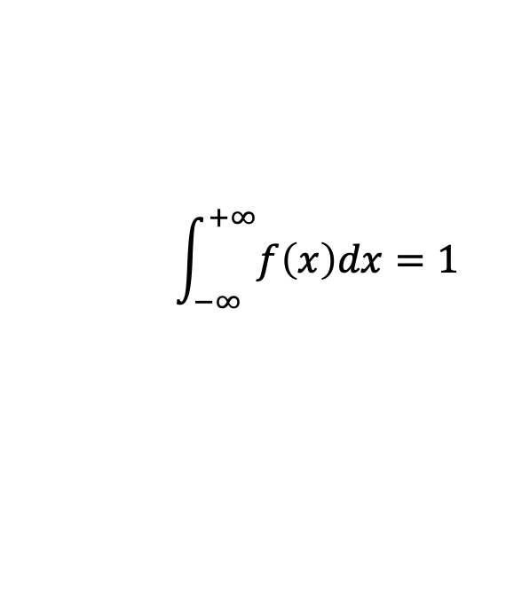

Continuous Random Variables
Q. What if the data is continuous?
A continuous random variable takes an infinite number of values
Cannot list all the possible values
Weight, height, time, etc.
The probability density function f(x) describes the distribution of a continuous random variable
For any number $a$, the area under the curve of f(x) between the negative infinity to $a$gives the probability that $X≤a$:
The density at any point x must not be less than zero: $f\left(x\right)≥0$
The area under the curve of f(x) must sum to one:
$$\int_{−∞}^{a}{f\left(x\right)dx=P(X≤a)}$$
$$\int_{−∞}^{+∞}{f\left(x\right)dx=1}$$

Slide 51

Continuous Random Variables
Some notation
X denotes the random variable
$x$ denotes a particular value / realization of X

Slide 52

Continuous Random Variables
Some notation
X denotes the random variable
$x$ denotes a particular value / realization of X
E.g.: The value of crop (X) can be $100M or $500M ($x$)

Slide 53

Continuous Random Variables
Some notation
X denotes the random variable
$x$ denotes a particular value / realization of X
E.g.: The value of crop (X) can be $100M or $500M ($x$)
Given some $x$
$P\left(X=x\right)$: probability that $X=x$

Slide 54
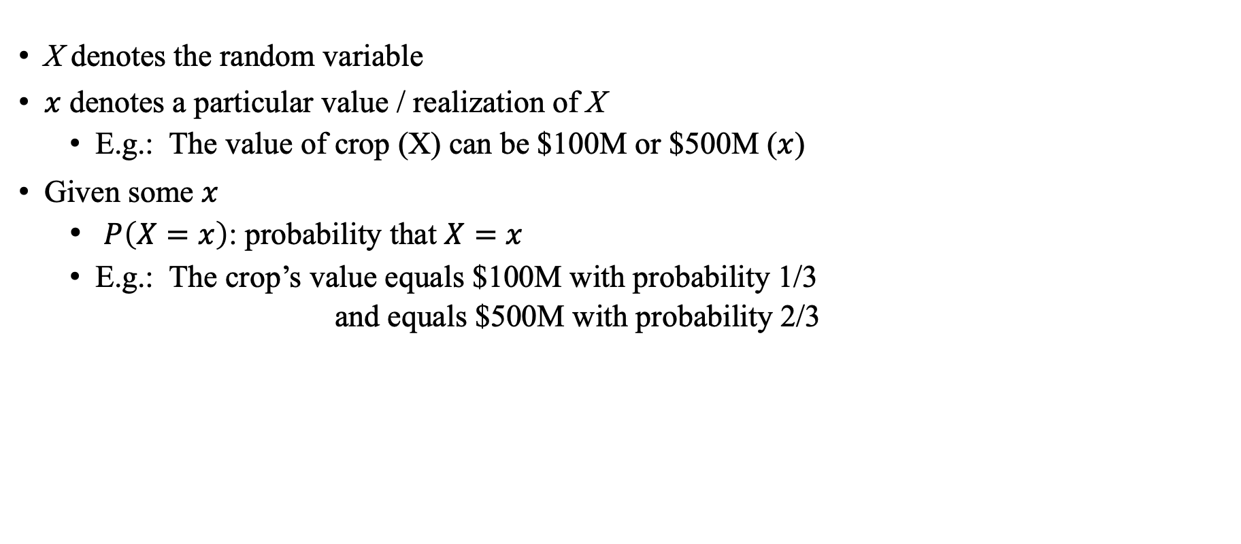
Continuous Random Variables
Some notation
X denotes the random variable
$x$ denotes a particular value / realization of X
E.g.: The value of crop (X) can be $100M or $500M ($x$)
Given some $x$
$P\left(X=x\right)$: probability that $X=x$
E.g.: The crop’s value equals $100M with probability 1/3
and equals $500M with probability 2/3

Slide 55


Continuous Random Variables
Some notation
X denotes the random variable
$x$ denotes a particular value / realization of X
E.g.: The value of crop (X) can be $100M or $500M ($x$)
Given some $x$
$P\left(X=x\right)$: probability that $X=x$
E.g.: The crop’s value equals $100M with probability 1/3
and equals $500M with probability 2/3
$$P\left(X=100M\right)=1/3$$
$$P\left(X=500M\right)=2/3$$

Slide 56
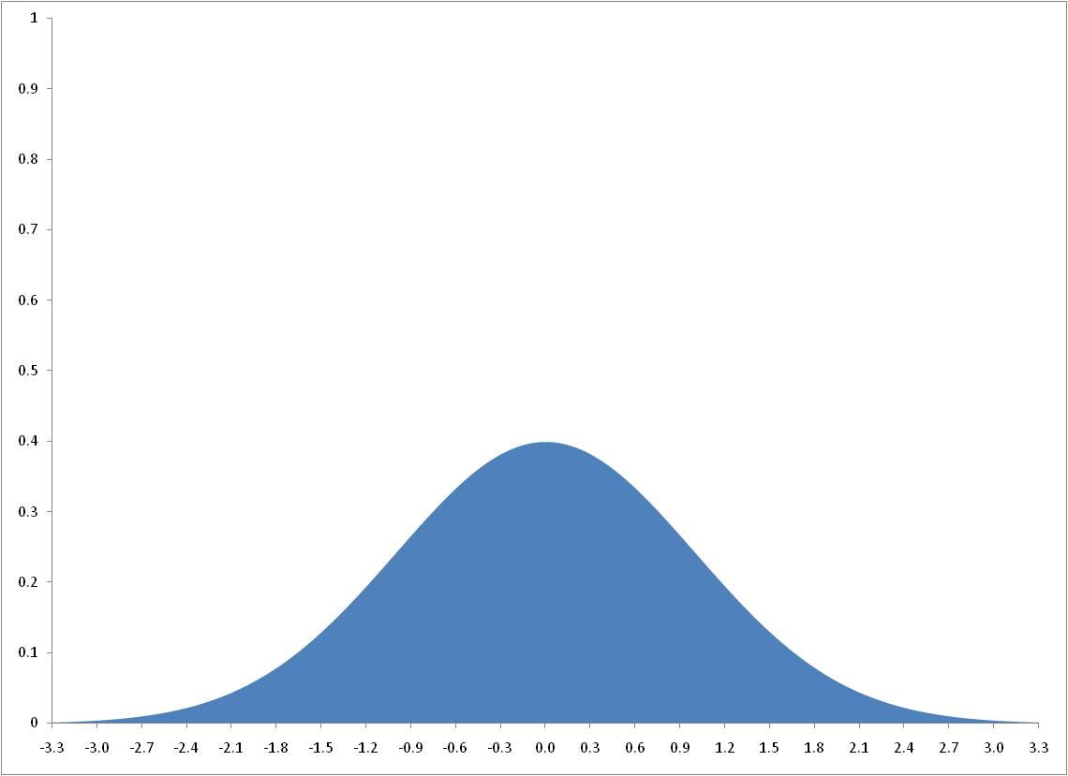
Continuous Random Variables
Probability Density Function of X : f(x)
Total Area = 1

Slide 57
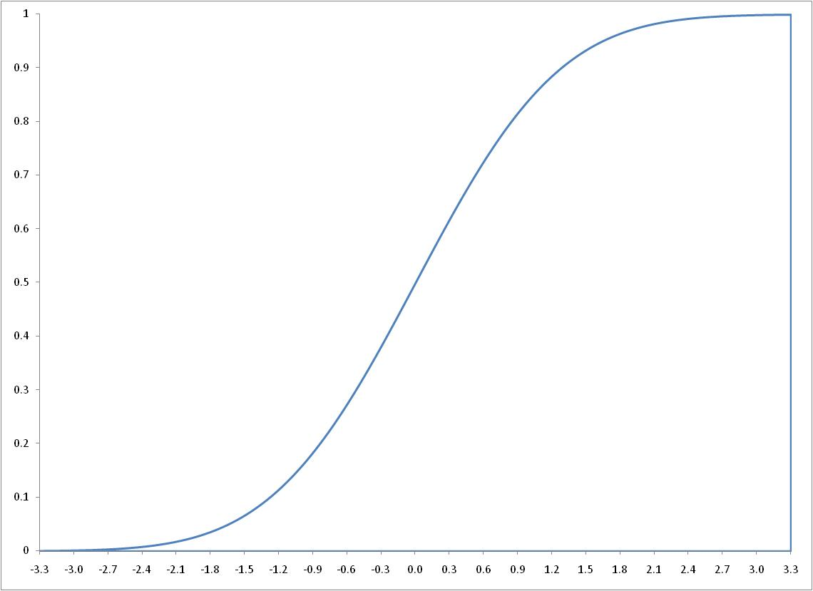
Continuous Random Variables
Probability Density Function of X : f(x)
Total Area = 1
Height: 1
Cumulative Density Function of X :
1

Slide 58
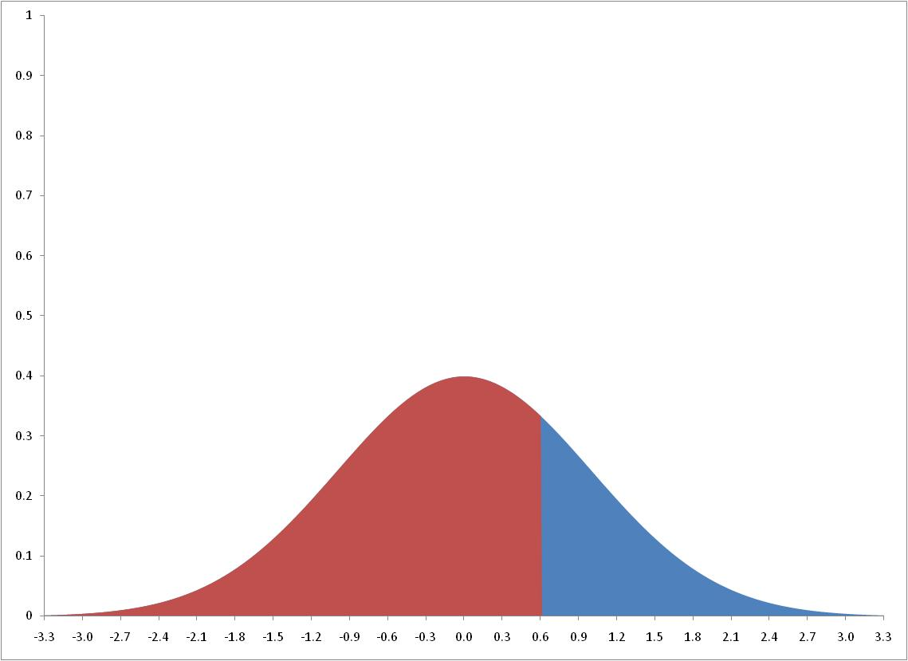


Continuous Random Variables
Probability Density Function of X : f(x)
$$Total Area: P(X≤ 0.6)$$
0.6
Cumulative Density Function of X :
$$Height: P(X≤ 0.6)$$
0.6

Slide 59
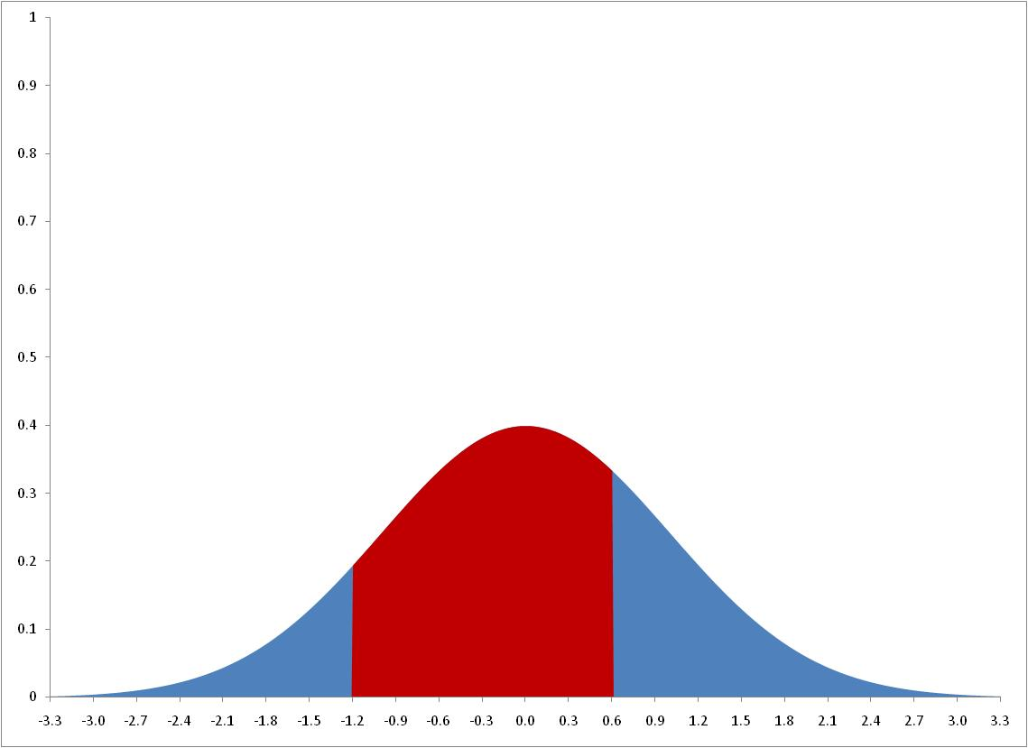




Continuous Random Variables
Probability Density Function of X : f(x)
$$P(−1.2 ≤ X≤ 0.6)$$
$$= P(X≤ 0.6) − P(X≤ −1.2)$$
-1.2
0.6
Cumulative Density Function of X :
$$P(X≤0.6)$$
$$P(X≤−1.2)$$
-1.2
0.6

Slide 60
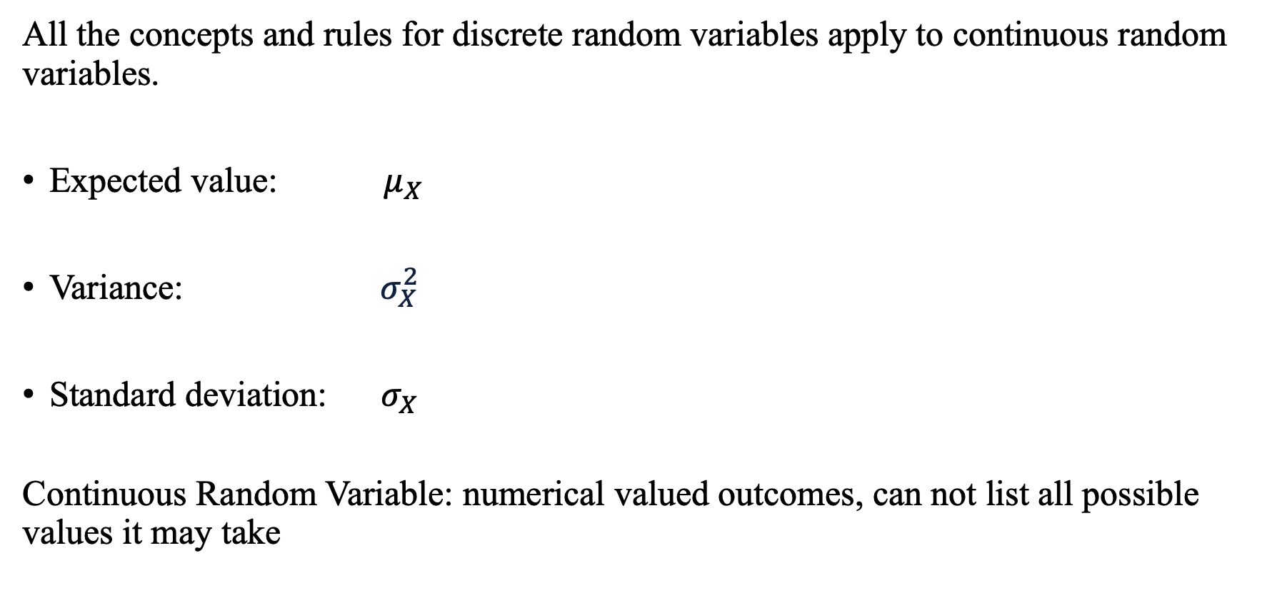
Continuous Random Variables
All the concepts and rules for discrete random variables apply to continuous random variables.
Expected value: ${ μ}_{X}$
Variance: $σ_{X}^{2}$
Standard deviation: $σ_{X}$
Continuous Random Variable: numerical valued outcomes, can not list all possible values it may take
measures the “center” of the distribution
measure the dispersion
of the distribution

Slide 61



Linear Combinations of R.V.
If random variable Y is a linear function of random variable X,
If $Y=a∙X$, then the expected value of $Y:$
If $Y=a∙X+b,$ then the expected value of $Y$:
$E(Y)=$ $a∙E(X)$
$E(Y)=$ $a∙E\left(X\right)+b$

Slide 62



Linear Combinations of R.V.
If random variable Y is a linear function of random variable X,
If $Y=a∙X+b∙Z$, then the expected value of $Y:$
If $Y=a∙X+b∙Z+c,$ then the expected value of $Y$:
$$E(Y)=a∙E\left(X\right)+b∙E(Z)$$
$E(Y)=$ $a∙E\left(X\right)+b∙E\left(Z\right)+c$

Slide 63
But how do we learn about the population?
Q. What can we say about the heights of all US residents?
Sampling
Population
Sample
Guess about population
(e.g., summary statistics)
Inference
Info about sample
(e.g., summary statistics)

Slide 64
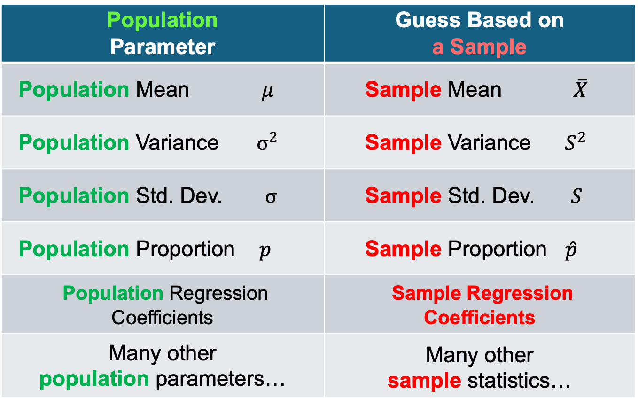
Sampling
Q. What can we say about the population from a sample?
Population Parameter | Guess Based on a Sample
Population Mean $μ$ | Sample Mean $\overline{X}$
Population Variance ${ σ}^{2}$ | Sample Variance${ S}^{2}$
Population Std. Dev. $σ$ | Sample Std. Dev. $S$
Population Proportion $p$ | Sample Proportion $\hat{p}$
Population Regression Coefficients | Sample Regression Coefficients
Many other population parameters… | Many other sample statistics…

Slide 65
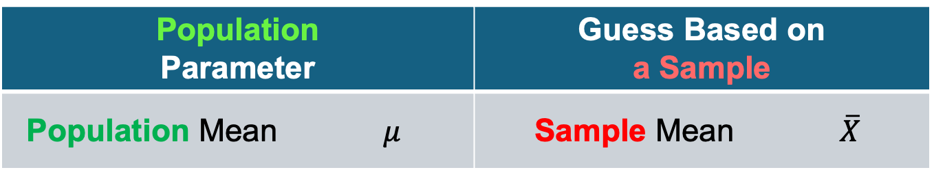
Sampling
Q. Is the sample mean a good guess for the population mean?
Population Parameter | Guess Based on a Sample
Population Mean $μ$ | Sample Mean $\overline{X}$

Slide 66
Sampling
Q. Is the sample mean a good guess for the population mean?
Yes, but we need some theory….
Population Parameter | Guess Based on a Sample
Population Mean $μ$ | Sample Mean $\overline{X}$

Slide 67
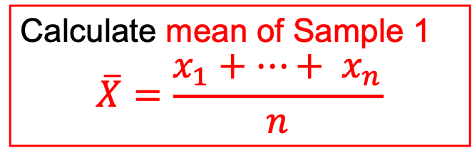

Sampling
How to guess the population mean: $μ_{X}$
Population
Sample 1
$$X$$
Calculate mean of Sample 1
$$\overline{X}=\frac{x_{1}+…+ x_{n}}{n}$$

Slide 68
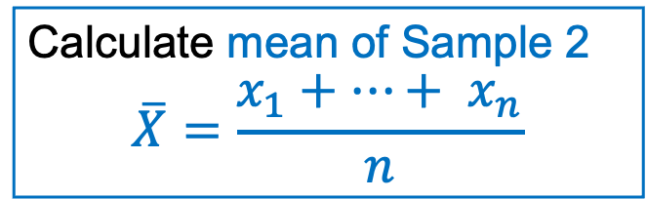
Sampling
How to guess the population mean: $μ_{X}$
Population
Sample 2
$$X$$
Calculate mean of Sample 2
$$\overline{X}=\frac{x_{1}+…+ x_{n}}{n}$$

Slide 69
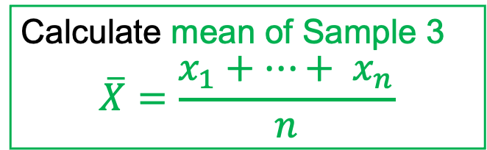
Sampling
How to guess the population mean: $μ_{X}$
Population
Sample 3
$$X$$
Calculate mean of Sample 3
$$\overline{X}=\frac{x_{1}+…+ x_{n}}{n}$$

Slide 70
Sampling
How to guess the population mean: $μ_{X}$
Population
sample mean
sample mean
$$X$$
sample mean

Slide 71
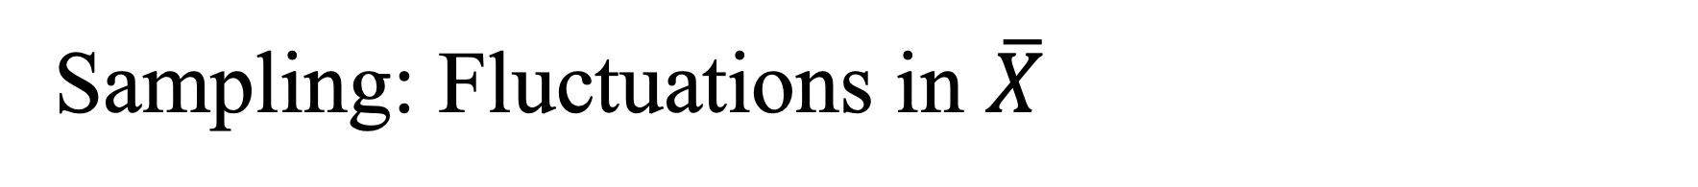
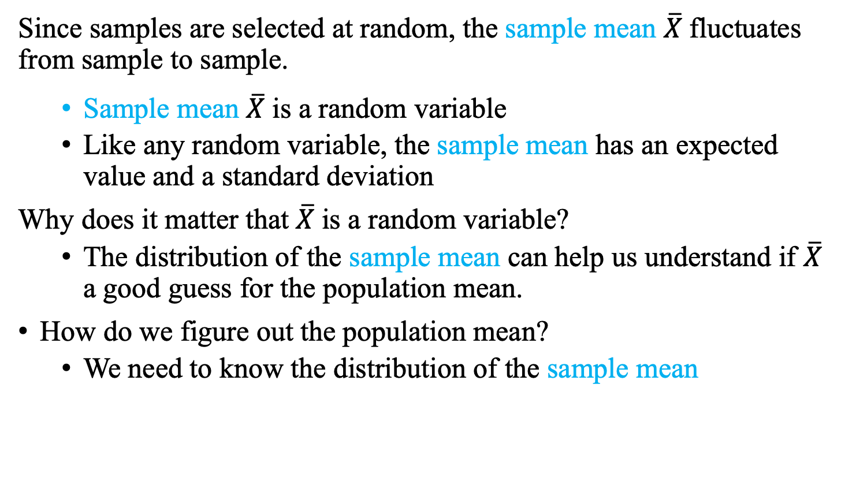
Sampling: Fluctuations in $\overline{X}$
How to guess the population mean: $μ_{X}$
Since samples are selected at random, the sample mean $\overline{X}$fluctuates from sample to sample.
Sample mean $\overline{X}$is a random variable
Like any random variable, the sample mean has an expected value and a standard deviation
Why does it matter that $\overline{X}$is a random variable?
The distribution of the sample mean can help us understand if $\overline{X}$ a good guess for the population mean.
How do we figure out the population mean?
We need to know the distribution of the sample mean

